Slide 1
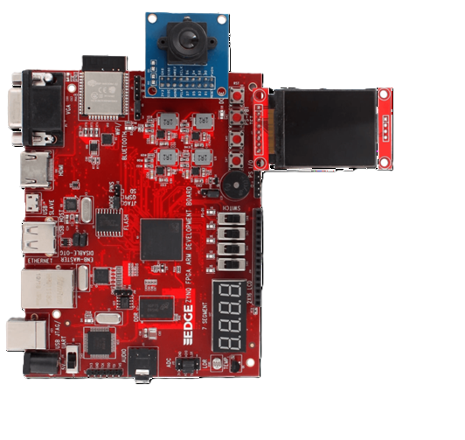
FPGA Based Object Detection Accelerator for Edge Devices

Slide 2
AGENDA
OBJECTIVE
LITERATURE SURVEY
PROBLEM STATEMENT
ABSTRACT
BLOCK DIAGRAM
REFERENCE PAPERS
CONCLUSION

Slide 3
LITERATURE SURVEY
S.No | Title | Journal | Year | Technologies
1 | A Reconfigurable CNN-Based Accelerator Design for Fast and Energy-Efficient Object Detection System on Mobile FPGA | IEEE Access | 2023 | CNN, RTL optimization, Clock Gating, Mobile FPGA
2 | Lightweight and Energy-Efficient Deep Learning Accelerator for Real-Time Object Detection on Edge Devices | Sensors | 2023 | TinyML, Model Compression, SqueezeNet, Xilinx ZC702 FPGA
3 | Efficient CNN Architecture on FPGA Using High-Level Module for Healthcare Devices | IEEE Access | 2022 | CNN, High-Level Synthesis, Low Power, FPGA
4 | Utilizing PYNQ for Accelerating Image Processing Functions in ADAS Applications | Archit. Comput. Syst. | 2019 | Image Processing, PYNQ, FPGA, ADAS

Slide 4
PROBLEM STATEMENT
Object detection is a key task in computer vision for applications such as surveillance, autonomous driving, and robotics.
Traditional systems rely on high-end CPUs or GPUs which consume more power and have higher latency.
Edge devices need real-time, low-power solutions.
FPGAs offer parallelism and energy efficiency, ideal for accelerating object detection models.

Slide 5
OBJECTIVES
Implement a lightweight object detection model (Tiny-YOLO) on a Zynq FPGA board.
Use webcam input to detect objects in real-time.
Perform inference acceleration on Programmable Logic (PL), while control and data handling is managed by ARM processor.
Enable efficient edge deployment with reduced latency.

Slide 6
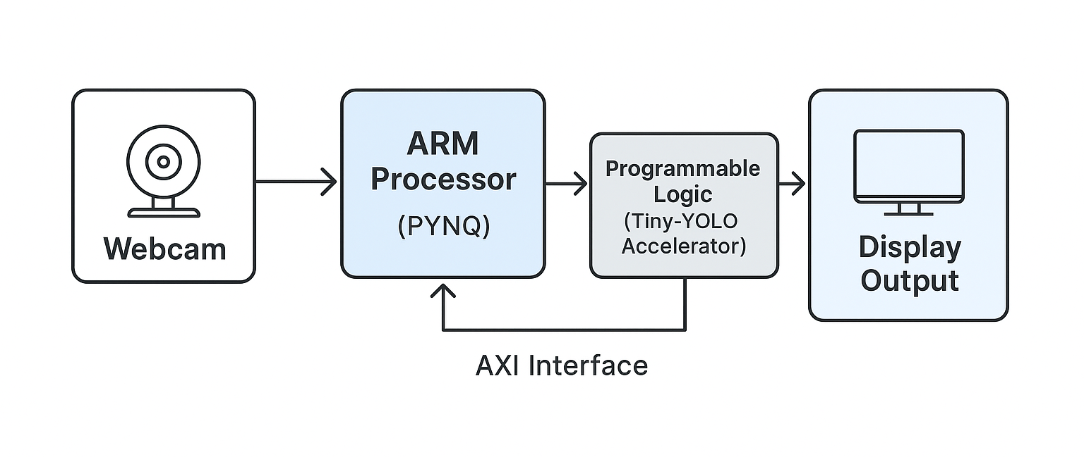
BLOCK DIAGRAM

Slide 7
MODEL DETAILS
Model: Tiny-YOLO (You Only Look Once v3)
Why Tiny-YOLO:
Lightweight, faster inference
Suitable for real-time embedded platforms
Input size: 416x416
Output: Bounding boxes with class confidence

Slide 8
WORKFLOW
Step 1: Capture image from webcam
Step 2: Send image to PL for inference
Step 3: Receive results (bounding boxes)
Step 4: Overlay and display results on frame

Slide 9
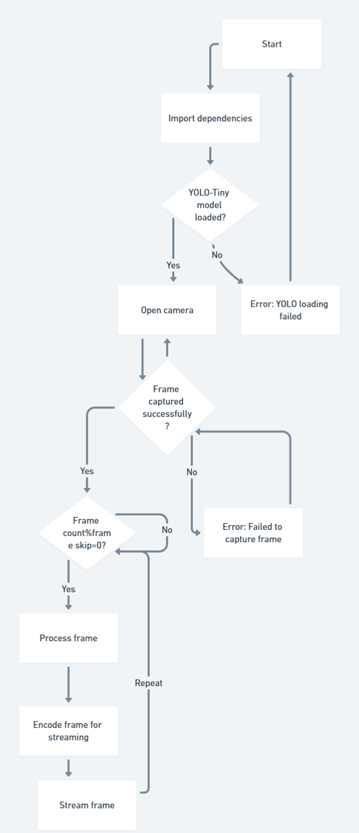
FLOWCHART

Slide 10
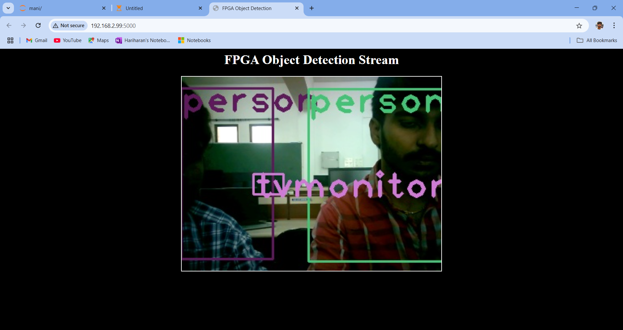
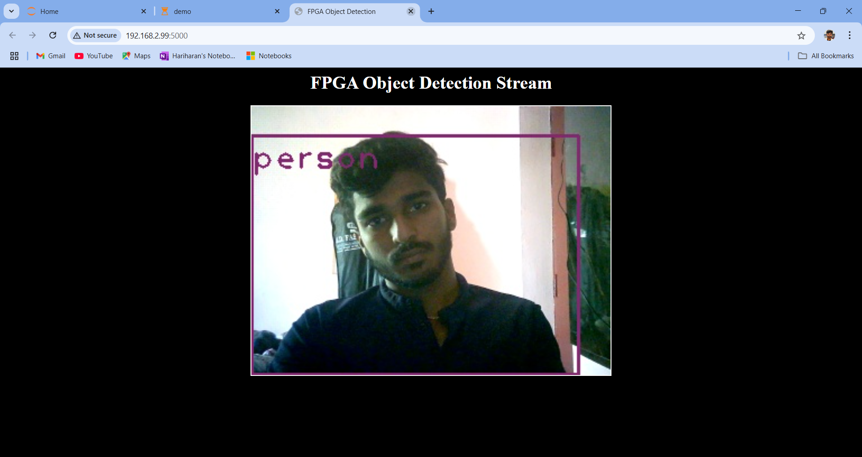
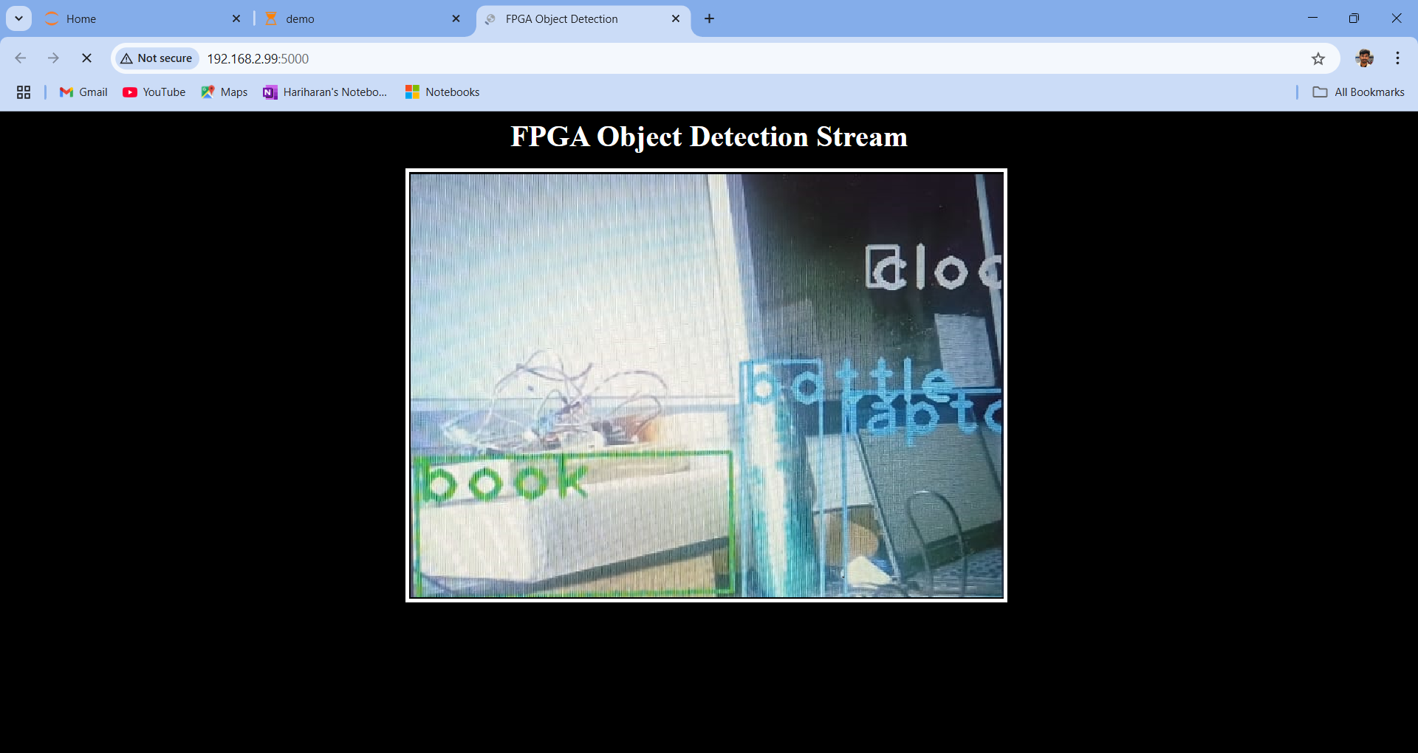
OUTPUT SAMPLES

Slide 11
CHALLENGES FACED
Model conversion for FPGA compatibility
Resource optimization on PL
Latency in data transfer between ARM and PL
Managing real-time video throughput with limited bandwidth

Slide 12
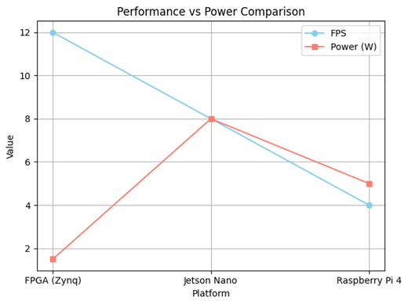
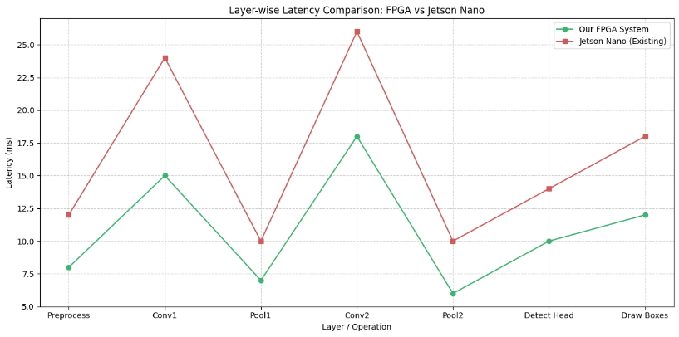
COMPARISON

Slide 13
COMPARISON
Activation | Inference Time (per frame) | Latency (ms) | Top-1 Accuracy (%) | Memory (MB) | Logic (LUTs)
ReLU | 18.0 ms | 1.5 ms | 84.5% | 0.1 | ~100
Leaky ReLU | 19.8 ms | 1.7 ms | 84.8% | 0.2 | ~130
PReLU | 22.5 ms | 2.1 ms | 85.3% | 0.4 | ~220
ReLU6 | 20.2 ms | 1.8 ms | 84.6% | 0.2 | ~150
Swish | 45.3 ms | 3.8 ms | 85.9% | 0.5 | ~600
Mish | 61.0 ms | 5.2 ms | 86.3% | 0.6 | ~800

Slide 14
CONCLUSION
Successfully implemented a real-time object detection accelerator using Zynq FPGA.
Demonstrated inference acceleration using Tiny-YOLO model.
FPGA proved effective for deploying deep learning at the edge with improved efficiency.
Future work can further optimize performance and generalize use cases.

Slide 15
REFERENCE
1. Kim, K., Jang, S.-J., Park, J., Lee, E., & Lee, S.-S. (2023). Lightweight and Energy-Efficient Deep Learning Accelerator for Real-Time Object Detection on Edge Devices. Sensors, 23(1185). doi:10.3390/s23031185
2. Heekyung, V., & Choi, K. (2023). A Reconfigurable CNN-Based Accelerator Design for Fast and Energy-Efficient Object Detection System on Mobile FPGA. IEEE Access, 11, 59438-59443. doi:10.1109/ACCESS.2023.3285279
3. Nikouei, S. Y., Chen, Y., Song, S., Xu, R., Choi, B., & Faughnan, T. (2018). Smart Surveillance as an Edge Network Service: From Harr-Cascade, SVM to a Lightweight CNN. In Proc. IEEE 4th Int. Conf. Collaboration Internet Comput.(pp. 256-265).
4. Zhang, Z., Mahmud, M. A. P., & Kouzani, A. Z. (2022). FitNN: A Low-Resource FPGA-Based CNN Accelerator for Drones. IEEE Internet Things J., 9(21), 21357-21369. doi:10.1109/TNSE.2022.3154412
5. Tamimi, S., Ebrahimi, Z., Khaleghi, B., & Asadi, H. An Efficient SRAM-Based Reconfigurable Architecture for Embedded Processors. IEEE Trans. Comput.-Aided Design Integr. Circuits Syst.
6. Fu, C., & Yu, Y. (2019). FPGA-Based Power Efficient Face Detection for Mobile Robots. In Proc. IEEE Int. Conf. Robot.Biomimetics (ROBIO), 467-473.
7. Jameil, A. K., & Al-Raweshidy, H. (2022). Efficient CNN Architecture on FPGA Using High-Level Module for HealthcareDevices. IEEE Access, 10, 60486-60495.
8. Li, X., Gong, X., Wang, D., Zhang, J., Baker, T., Zhou, J., & Lu, T. (2022). ABM-SpConv-SIMD: Accelerating Convolutional Neural Network Inference for Industrial IoT Applications on Edge Devices. IEEE Trans. Netw. Sci. Eng.
9. Haeublein, K., Brueckner, W., Vaas, S., Rachuj, S., Reichenbach, M., & Fey, D. (2019). Utilizing PYNQ for Accelerating Image Processing Functions in ADAS Applications. Proc. 32nd Int. Conf. Archit. Comput. Syst.
10. Li, X., et al. (2022). Efficient SRAM-Based Reconfigurable Architecture for Industrial IoT Applications. IEEE Trans.

